Slide 1

Go, change the world
RV College of
Engineering
Diabetes Prediction using machine learning
16EC73P : B.E. Minor Project Phase 1 Presentation
NAME : Manoj Naik USN : 1RV17EC073
NAME : Mayur Raj Singh Chauhan USN : 1RV17EC075
NAME : Paurush Gupta USN : 1RV17EC097
Guide Name: Dr. Rajani Katiyar
Designation: Assistant Professor
Department of Electronics and Communication Engineering
*
Department of ECE
1

Slide 2

Go, change the world
RV College of
Engineering
OUTLINE
Introduction
Motivation
Literature Survey
Problem Statement
Objectives of the project
Methodology
Project timeline
References
*
Department of ECE
2

Slide 3
Go, change the world
RV College of
Engineering
INTRODUCTION
Diabetes is an illness which affects the ability of the body in producing the hormone insulin, which in turn makes the metabolism of carbohydrate abnormal and raise the levels of glucose in the blood.
Person generally suffers from high sugar level in blood which can have severe effects on other human organs.
Insulin is an essential hormone produced by the pancreas that allows the cells to absorb glucose (blood sugar) from food supplies in order to provide them the necessary energy.
Some of the symptoms are Intensify thirst, Intensify hunger and Frequent urination.
*
Department of ECE
3

Slide 4
Go, change the world
RV College of
Engineering
INTRODUCTION
In medicine, doctors and current research confirm that if this disease is discovered at an early stage, the chances of recovery will be greater.
But the identifying process is tedious, visiting to a diagnostic center and consulting doctor, i.e. these tests take a lot of time and waste budget of health care systems and people every year.
But the rise in machine learning approaches gives solution to this problem.
The learning algorithms use recorded datasets of former patient’s information to prepare a model and then use this model with information of an unseen patient to predict if the patient has the desired disease or not.
*
Department of ECE
4

Slide 5
Go, change the world
RV College of
Engineering
MOTIVATION
Diabetes is considered as one of the deadliest and chronic diseases and many complications may occur if it remains untreated or unidentified.
In medicine, doctors and current research confirm that if this disease is discovered at an early stage, the chances of recovery will be greater.
This motivated us to build a user friendly AI model which can predict the probability for a person of having diabetes using recorded data of former patients.
*
Department of ECE
5

Slide 6
Go, change the world
RV College of
Engineering
LITERATURE SURVEY
Sl No | Paper Title Journal Name, Year | Major findings / observations
1 | M. K. Hasan, M. A. Alam, D. Das, E. Hossain and M. Hasan, "Diabetes Prediction Using Ensembling of Different Machine Learning Classifiers," in IEEE Access, vol. 8, 2020. | Diabetes prediction has been accomplished using the model from the Pima Indian Diabetes dataset. The quality of the dataset was improved by the proposed pre processing scheme. Performance of model is decided with the help of confusion matrix .
*
Department of ECE
6

Slide 7
Go, change the world
RV College of
Engineering
LITERATURE SURVEY
Sl No | Paper Title Journal Name, Year | Major findings / observations
2 | H. Roopa and T. Asha, "A Linear Model Based on Principal Component Analysis for Disease Prediction," in IEEE Access, vol. 7,2019 | Feature extraction and statistical modelling on PIDD is presented in this research work. The PIDD (Pima Indian Diabetes Data) features are extracted to a new space using PCA(Principal component analysis). These newly projected features are then modelled using Linear Regression Model. The results obtained in this study have achieved high accuracy rate (82.1%) for predicting diabetes when compared with other existing methods.
*
Department of ECE
7

Slide 8
Go, change the world
RV College of
Engineering
LITERATURE SURVEY
Sl No | Paper Title Journal Name, Year | Major findings / observations
3 | Diabetes Prediction using Machine Learning Algorithms,Aishwarya Mujumdara, Dr. Vaidehi Vb, international conference on recent trends in advanced computing 2019, icrtac 2019. | In this paper various machine learning algorithms are applied on the dataset and the classification has been done using various algorithms. Logistic Regression gives highest accuracy of 76%. Application of pipeline gave AdaBoost classifier as best model with accuracy of 77%. It is clear that the model improves accuracy and precision of diabetes prediction with this dataset compared to existing dataset.
*
Department of ECE
8

Slide 9
Go, change the world
RV College of
Engineering
LITERATURE SURVEY
Sl No | Paper Title Journal Name, Year | Major findings / observations
4 | A. Yahyaoui, A. Jamil, J. Rasheed and M. Yesiltepe, "A Decision Support System for Diabetes Prediction Using Machine Learning and Deep Learning Techniques," 2019 1st International Informatics and Software Engineering Conference (UBMYK), Ankara, Turkey, 2019. | This paper shows A comparative analysis of machine learning and deep learning-based algorithms for prediction of diabetes. It showed that RF was more effective for classification of the diabetes in all rounds of experiments which produced overall accuracy for diabetic prediction to be 83.67%. The prediction accuracy for SVM reached 65.38% while DL method produced 76.81% on dataset.
*
Department of ECE
9

Slide 10
Go, change the world
RV College of
Engineering
LITERATURE SURVEY
Sl No | Paper Title Journal Name, Year | Major findings / observations
5 | D. Dutta, D. Paul and P. Ghosh, "Analysing Feature Importances for Diabetes Prediction using Machine Learning," 2018 IEEE 9th Annual Information Technology, Electronics and Mobile Communication Conference (IEMCON), Vancouver, BC, 2018. | This paper showed that It conclude that Random Forest is the most ideal algorithm for predicting Diabetes. If people want to prevent Diabetes, they should really keep their glucose level down and with increase in age they should follow a proper diet. Also people born in families having a diabetic history, they should really take care of themselves.
*
Department of ECE
10

Slide 11
Go, change the world
RV College of
Engineering
LITERATURE SURVEY
Sl No | Paper Title Journal Name, Year | Major findings / observations
6 | P. Sonar and K. JayaMalini, "Diabetes Prediction Using Different Machine Learning Approaches," 2019 3rd International Conference on Computing Methodologies and Communication (ICCMC), Erode, India, 2019. | SVM: Are very good when we have no idea on the data. Even with unstructured and semi structured data. The drawback of the SVM algorithm is that to achieve the best classification results for any given problem, several key parameters are needed to be set correctly. Decision tree: It is easy to understand and rule decision tree. Naive Bayes: It is robust, handles the missing values by ignoring probability estimation calculation. ANN: Gives good prediction and easy to implement. Difficult with dealing with big data with complex model. Require huge processing time.
*
Department of ECE
11

Slide 12
Go, change the world
RV College of
Engineering
LITERATURE SURVEY
Sl No | Paper Title Journal Name, Year | Major findings / observations
7 | R. Mirshahvalad and N. A. Zanjani, "Diabetes prediction using ensemble perceptron algorithm," 2017 9th International Conference on Computational Intelligence and Communication Networks (CICN), Girne, 2017. | This study proposed a learning algorithm to help the prediction of undiagnosed patients in an easy, accessible and affordable way for people around the world. The proposed algorithm, ensembles boosting algorithm with perceptron algorithm, which uses more than one weight vector for the test data classification. The proposed algorithm is validated on three different NHANES datasets confirming that AUC value improves from 0.72 to 0.75 by the proposed algorithm. In addition, it is shown that execution time overload of proposed algorithm is not considerably higher compared to perceptron algorithm.
*
Department of ECE
12

Slide 13
Go, change the world
RV College of
Engineering
LITERATURE SURVEY
Sl No | Paper Title Journal Name, Year | Major findings / observations
8 | H. Abbas, L. Alic, M. Rios, M. Abdul-Ghani and K. Qaraqe, "Predicting Diabetes in Healthy Population through Machine Learning," 2019 IEEE 32nd International Symposium on Computer-Based Medical Systems (CBMS), Cordoba, Spain, 2019. | In this paper, they have used the linear support vector machines to construct a prediction model of future development of type-2 diabetes. The outcomes of the study show that high values of glucose observed at the 2 h mark during the OGTT may strongly indicate the potential risk of future development of type-2 diabetes. In a possible extension of this study, the prediction models may be applied on other similar datasets that include the OGTT measurements.
*
Department of ECE
13

Slide 14
Go, change the world
RV College of
Engineering
LITERATURE SURVEY
Sl No | Paper Title Journal Name, Year | Major findings / observations
9 | K. VijiyaKumar, B. Lavanya, I. Nirmala and S. S. Caroline, "Random Forest Algorithm for the Prediction of Diabetes," 2019 IEEE International Conference on System, Computation, Automation and Networking (ICSCAN), Pondicherry, India, 2019. | In this study, systematic efforts area unit created in coming up with a system that finally ends up among the prediction of illness like genetic defect. Throughout this work Random Forest algorithms area unit studied and evaluated on varied measures. The aim of this project is to develop a system which can perform early prediction of diabetes for a patient with a higher accuracy by using machine learning technique which provides advance support for predicting the accuracy rate of diabetes.
*
Department of ECE
14

Slide 15
Go, change the world
RV College of
Engineering
LITERATURE SURVEY
Sl No | Paper Title Journal Name, Year | Major findings / observations
10 | P. K. Saha, N. S. Patwary and I. Ahmed, "A Widespread Study of Diabetes Prediction Using Several Machine Learning Techniques," 2019 22nd International Conference on Computer and Information Technology (ICCIT), Dhaka, Bangladesh, 2019. | In this study, there are several comparsion between algorithms with different preprocessing techniques and identify algorithms best performance in which preprocessing technique. It also shows that Neural Network was given best accuracy(80.4%) than any other methods. Comparing the execution time of several methods in it’s the best accuracy and found Naive Bayes was taken less execution time than any other methods
*
Department of ECE
15

Slide 16
Go, change the world
RV College of
Engineering
PROBLEM STATEMENT
To build a machine learning model to accurately predict the probability of having Diabetes .
Creating a web application using flask and connection it with model.
Deploy model on cloud platform using PaaS.
*
Department of ECE
16

Slide 17
Go, change the world
RV College of
Engineering
OBJECTIVES OF THE PROJECT
To build a efficient model which can predict the probability of having Diabetes.
To increase the model efficiency of model with help of data processing and hyperparameter tuning.
To build a cloud based user friendly interface .
*
Department of ECE
17

Slide 18
Go, change the world
S
RV College of
Engineering
DESIGN METHODOLOGY
Creating a model using machine learning
Preprocessing of data
Importing the necessary libraries
Loading of dataset in K Fold
Loading the dataset
Modeling and Training of different algorithms
Improving AUC(ROC) using Hyperparameters.
Selecting the best model
Save and Load the model
Department of ECE
18

Slide 19
Go, change the world
RV College of
Engineering
DESIGN METHODOLOGY
Creation of user friendly environment for model
Creating a web app using flask and connecting it with stored model
Commit project to GitHub
Deploy our model using Heroku
*
Department of ECE
19

Slide 20
Go, change the world
RV College of
Engineering
DETAILS OF SOFTWARE / HARDWARE
Python
Python is a widely used high-level programming language for general-purpose programming.
Jupyter notebook
JupyterLab is a web-based interactive development environment for Jupyter notebooks, code, and data. JupyterLab is flexible: configure and arrange the user interface to support a wide range of workflows in data science, scientific computing, and machine learning.
*
Department of ECE
20

Slide 21
Go, change the world
RV College of
Engineering
DETAILS OF SOFTWARE / HARDWARE
Flask
Flask is a web framework. This means flask provides you with tools, libraries and technologies that allow you to build a web application.
GitHub
GitHub is a web-based platform used for version control. Git simplifies the process of working with other people and makes it easy to collaborate on projects.
Heroku
Heroku is a cloud Platform as a Service (PaaS). Developers use Heroku to deploy, manage, and scale modern apps.
*
Department of ECE
21

Slide 22
Go, change the world
RV College of
Engineering
TIMELINE OF THE PROJECT
Literature survey Requirement analysis
Hyper tuning and data cleaning
Integrate model web application on a PaaS
5-10-20
15-11-20
8-12-20
31-10-20
31-11-20
Building varies model and improving accuracy of model
Build a web application for user interface of model
Department of ECE
22

Slide 23
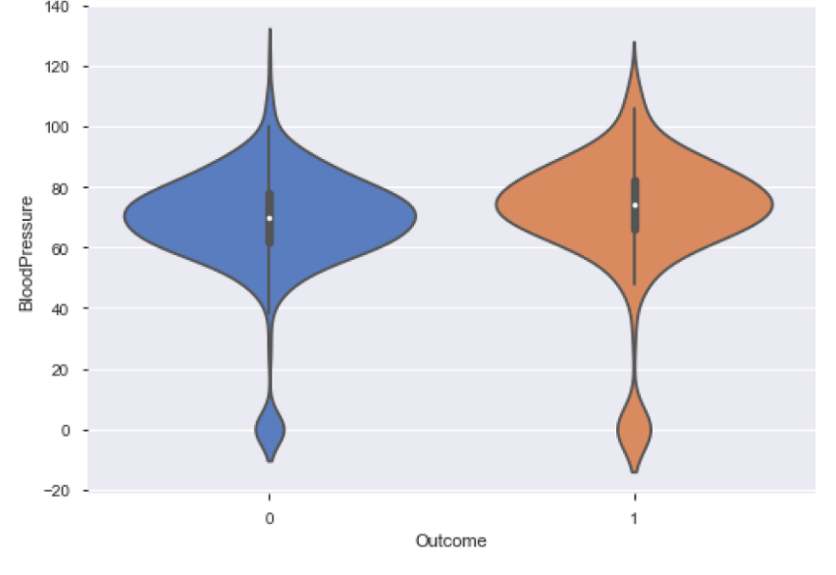
Go, change the world
RV College of
Engineering
Exploratory Data Analysis
It can be seen that the box plot for 1 (Diabetic) inside the violin is a little more away from the horizontal axis than the box plot for 0 (Non Diabetic).
It can be implied that diabetics seem to have a higher blood pressure than the non-diabetics
*
Department of ECE
23

Slide 24
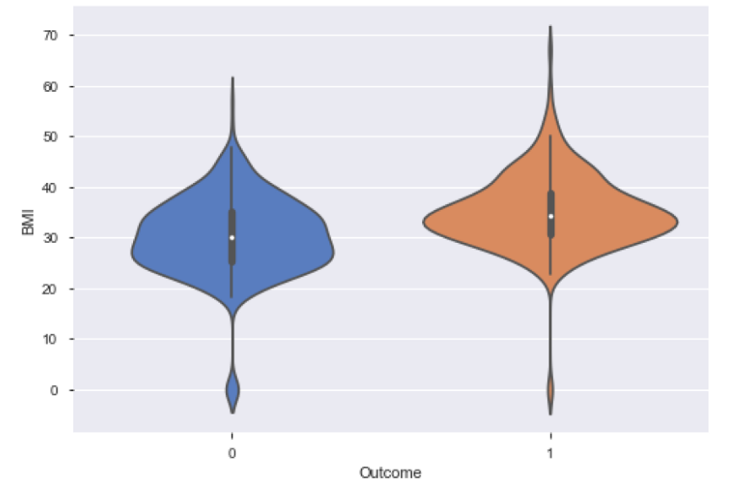
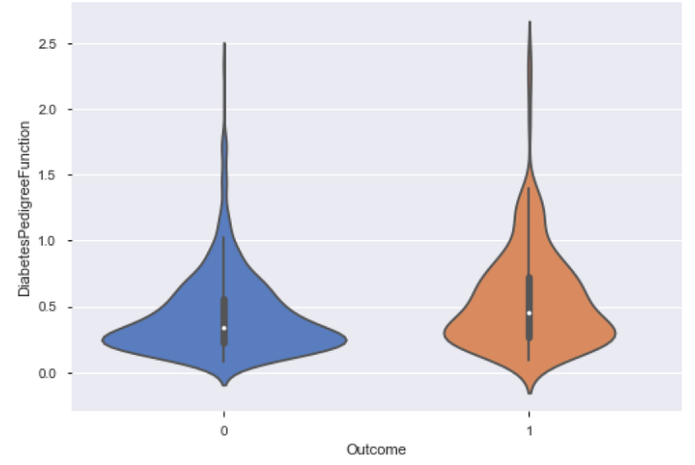
Go, change the world
RV College of
Engineering
Exploratory Data Analysis
*
Department of ECE
24

Slide 25
Go, change the world
RV College of
Engineering
EXPLORATORY DATA ANALYSIS
It can be seen that the box plot for 1 (Diabetic) inside the violin is a little more away from the horizontal axis than the box plot for 0 (Non Diabetic).
It can be implied that diabetics seem to have a higher blood pressure than the non-diabetics
*
Department of ECE
25

Slide 26
Go, change the world
RV College of
Engineering
DATA PROCESSING
They are missing values in the dataset which need to be removed.
Missing value are replaced with the mean of that attribute.
*
Department of ECE
26

Slide 27
Go, change the world
RV College of
Engineering
Outlier rejection
the missing or null values were imputed by the mean values.
after that they were processed for outlier rejection
The outlier is a markedly deviated observation from other observations. It requires to be rejected from data distribution as the classifiers are very much sensitive to the data range and distribution of the attributes
*
Department of ECE
27

Slide 28
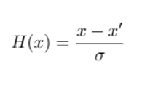
Go, change the world
RV College of
Engineering
Z score standardization
The standardization or Z-score normalization is the technique to rescale the attributes for achieving standard normal distribution with zero mean and unit variance.
*
Department of ECE
28

Slide 29
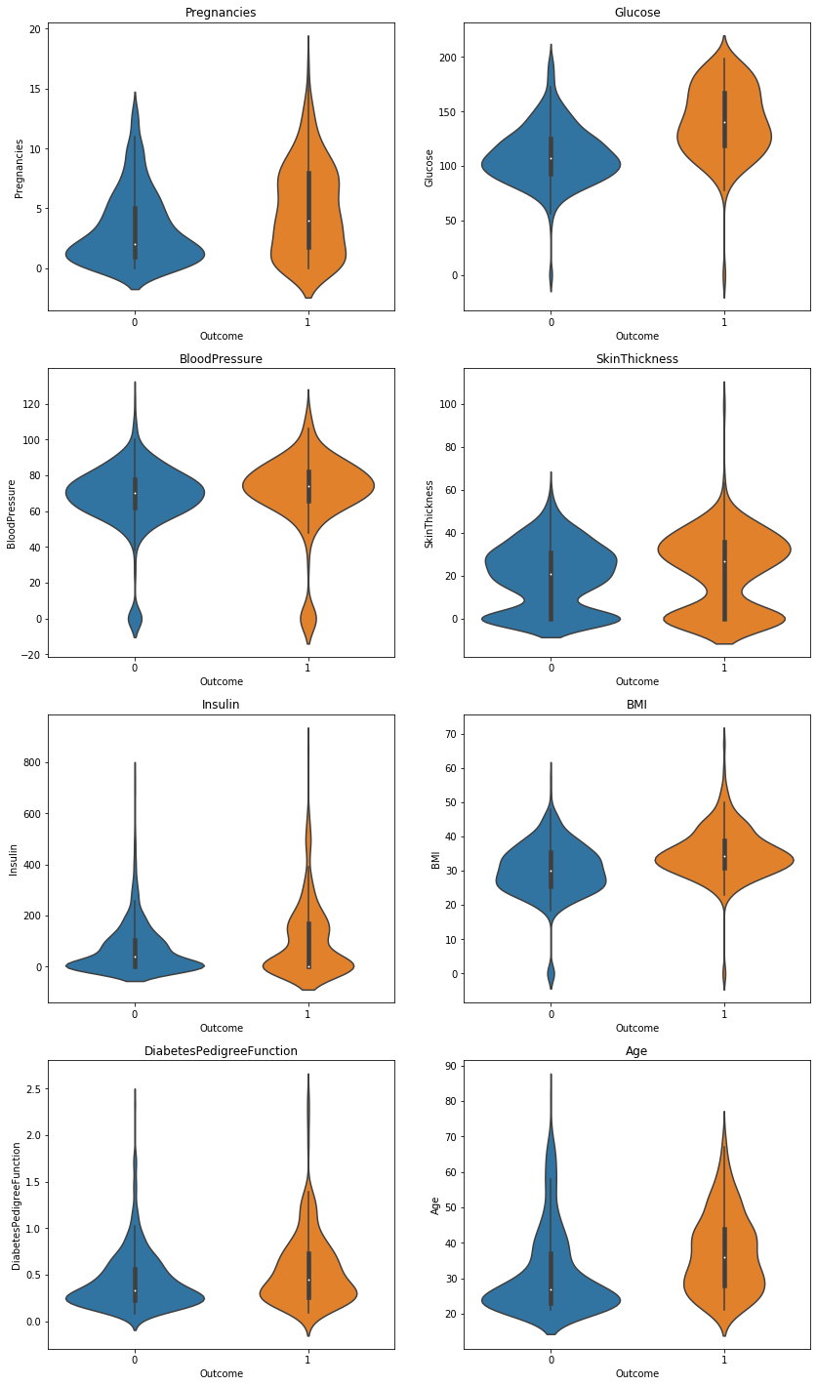
Go, change the world
RV College of
Engineering
BEFORE DATA PROCESSING
*
Department of ECE
29

Slide 30
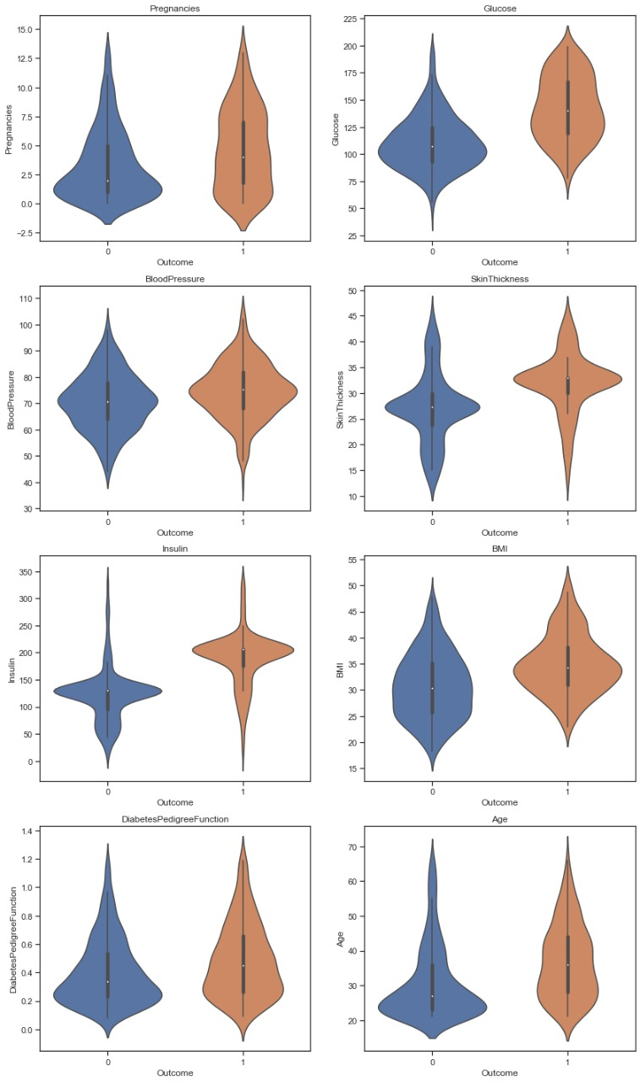
Go, change the world
RV College of
Engineering
AFTER DATA PROCESSING
*
Department of ECE
30

Slide 31
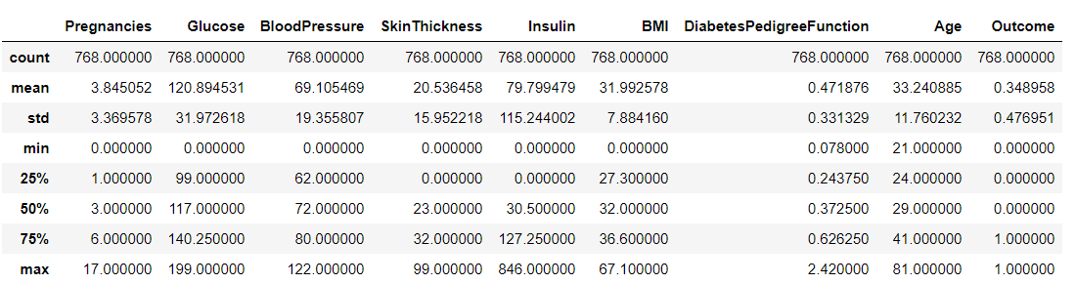
Go, change the world
RV College of
Engineering
STATISTICAL DESCRIPTION OF RAW DATA
*
Department of ECE
31

Slide 32
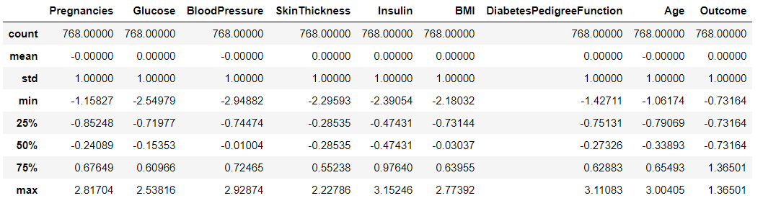
Go, change the world
RV College of
Engineering
STATISTICAL DESCRIPTION OF PROCESSED DATA
*
Department of ECE
32

Slide 33
Go, change the world
RV College of
Engineering
ALGORITHMS IMPLEMENTED
The redundant data from the dataset was replaced with the mean of corresponding attribute
The following algorithms were implemented for finding better result
Logistic Regression
Random Forest Classifier
Support Vector Machine
K nearest neighbors
Gaussian
Ada boost
XGB Boost
*
Department of ECE
33

Slide 34
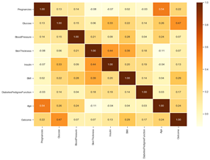
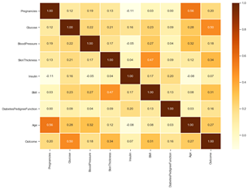
Go, change the world
RV College of
Engineering
RESULTS OF PREPROCESSING
The presence of Outliers lead to an increase in skewness of the data set and underestimate the expected value. By using outlier rejection the skewness of the dataset was reduced and the standardization of the dataset also improves the skewness.
fig 1 : Correlation matrix of raw data
fig 2 : Correlation matrix of processed data
*
Department of ECE
34

Slide 35
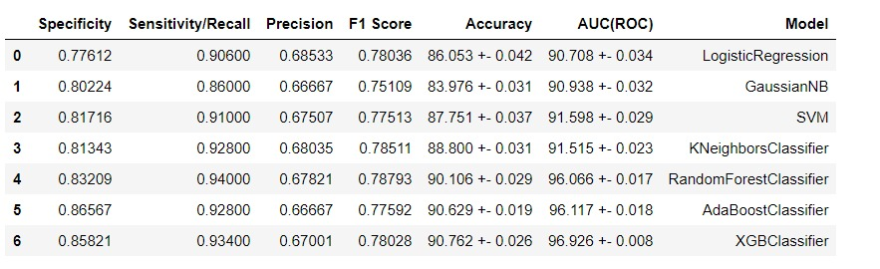
Go, change the world
RV College of
Engineering
RESULTS OF MODEL TRAINING
*
Department of ECE
35

Slide 36
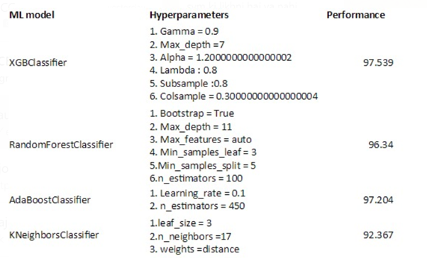
Go, change the world
RV College of
Engineering
HYPARAMETERS
*
Department of ECE
36

Slide 37
Go, change the world
RV College of
Engineering
RESULTS OF HYPERMETERS
Table : Precision F1 score Accuracy for different algorithm
Table : Specificity , Sensitivity and AUC(ROC) for different algorithm
Classifier | precision | F1-Score | Accuracy
XGB classifier | 0.675 | 0.787 | 91.020
Random Forest Classifier | 0.671 | 0.778 | 90.367
AdaBoost Classifier | 0.671 | 0.787 | 92.061
K Neighbors Classifier | 0.6789 | 0.780 | 88.023
Classifier | Specificity(Sp) | Sensitivity(Sn) | AUC(ROC)%
XGB classifier | 0.847 | 0.944 | 97.539
Random Forest Classifier | 0.843 | 0.926 | 96.34
AdaBoost Classifier | 0.865 | 0.950 | 97.204
K Neighbors Classifier | 0.809 | 0.918 | 92.367
*
Department of ECE
37

Slide 38
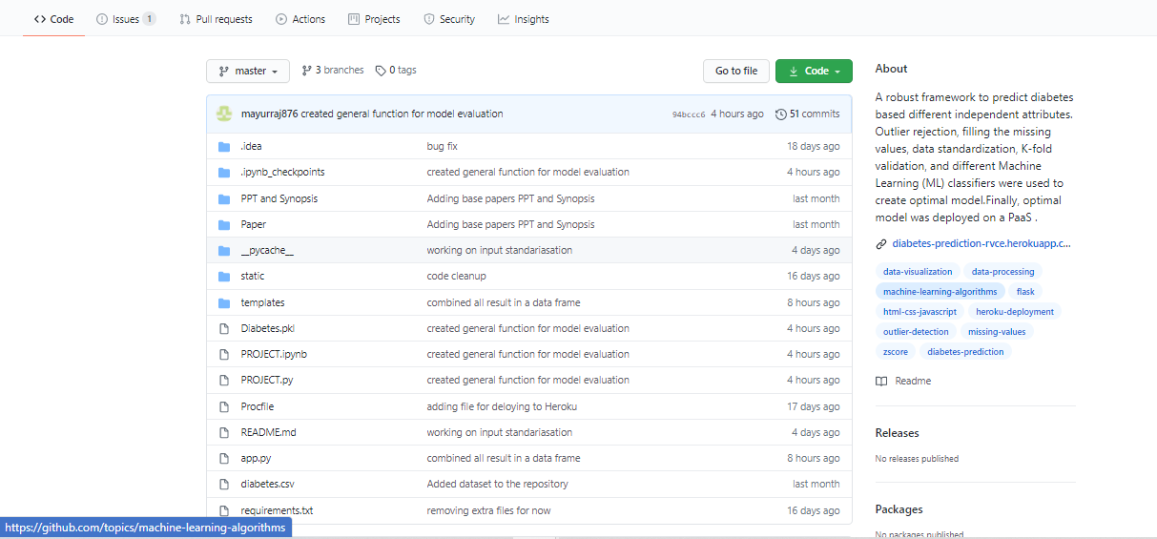
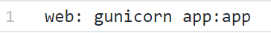
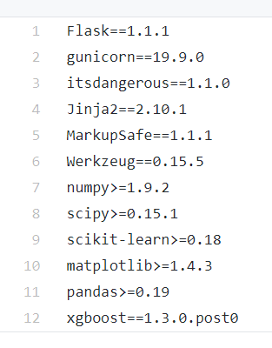
Go, change the world
RV College of
Engineering
RESULTS OF CLOUD DEPLOYMENT
The best trained model was committed to GitHub.
1.Procfile
2.Repuirements.txt
*
Department of ECE
38

Slide 39
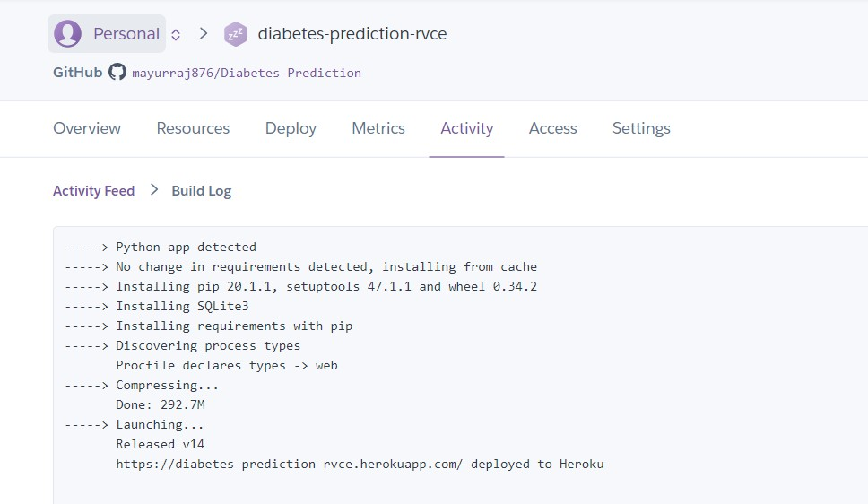
Go, change the world
RV College of
Engineering
RESULTS OF CLOUD DEPLOYMENT
Then the project is deployed in Heroku cloud platform.
*
Department of ECE
39

Slide 40
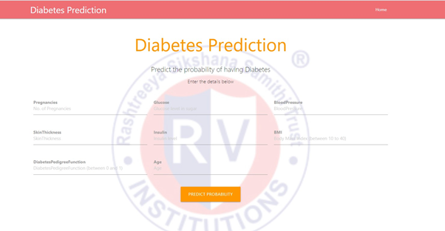
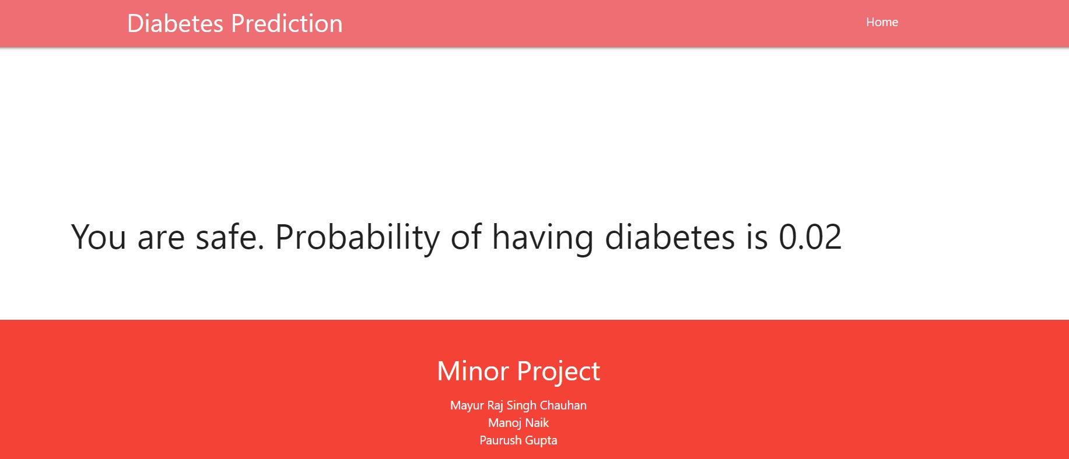
Go, change the world
RV College of
Engineering
RESULTS OF CLOUD DEPLOYMENT
*
Department of ECE
40

Slide 41
Go, change the world
RV College of
Engineering
REFERENCES
Sl No | Author, Title of paper, Journal | Year
1 | Yahyaoui, A. Jamil, J. Rasheed and M. Yesiltepe, "A Decision Support System for Diabetes Prediction Using Machine Learning and Deep Learning Techniques," 2019 1st International Informatics and Software Engineering Conference (UBMYK), Ankara, Turkey, 2019, pp. 1-4, doi: 10.1109/UBMYK48245.2019.8965556. | 2019
2 | D. Dutta, D. Paul and P. Ghosh, "Analysing Feature Importances for Diabetes Prediction using Machine Learning," 2018 IEEE 9th Annual Information Technology, Electronics and Mobile Communication Conference (IEMCON), Vancouver, BC, 2018, pp. 924-928, doi: 10.1109/IEMCON.2018.8614871. | 2018
3 | P. Sonar and K. JayaMalini, "Diabetes Prediction Using Different Machine Learning Approaches," 2019 3rd International Conference on Computing Methodologies and Communication (ICCMC), Erode, India, 2019, pp. 367-371, doi: 10.1109/ICCMC.2019.8819841. | 2019
*
Department of ECE
41

Slide 42
Go, change the world
RV College of
Engineering
Thank You
*
Department of ECE
42

